Slide 1
The Ocean Biogeographic Information System (OBIS)
Pieter Provoost
IOC-UNESCO

Slide 2
OBIS
2000 - 2010: created as data repository and information dissimination system for the Census of Marine Life
2009: adopted by the Intergovernmental Oceanographic Commission of UNESCO, under the IODE programme
secretariat moved from Rutgers University to Ostend, Belgium

Slide 3
OBIS
The OBIS community
Regional nodes
EurOBIS
MedOBIS
CAFF ...
Thematic nodes
Ocean Tracking Network (OTN)
Oceans Past Initiative (OPI)
OBIS SEAMAP ...
OBIS Secretariat

Slide 5
OBIS
Data flow

Slide 6
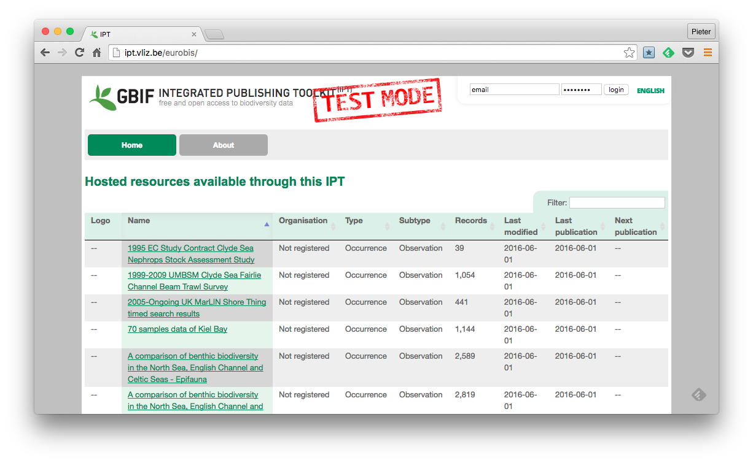
OBIS
Integrated Publishing Toolkit (IPT)

Slide 7
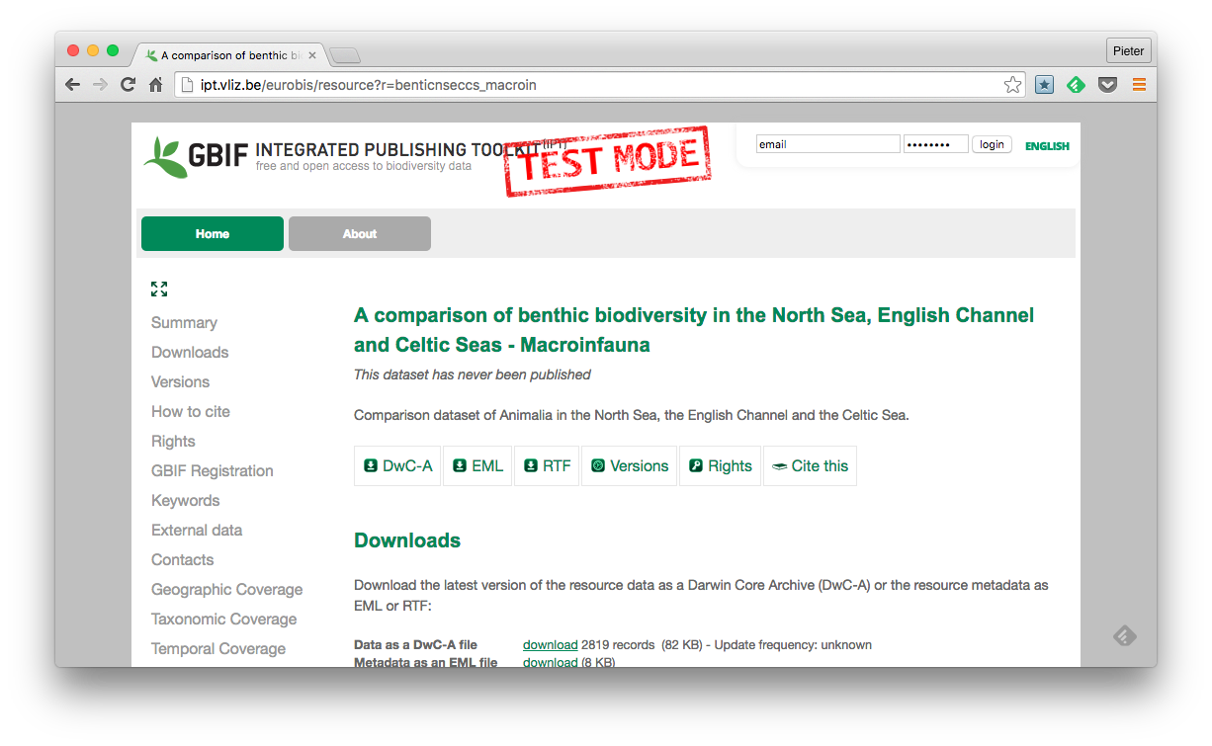
OBIS
Integrated Publishing Toolkit (IPT)

Slide 8
OBIS
Some numbers
2088 datasets from 600 data providers
47,000,000 records
105,000 species

Slide 9
OBIS
Demo
Mapper
Exploration portal
R package

